Slide 1
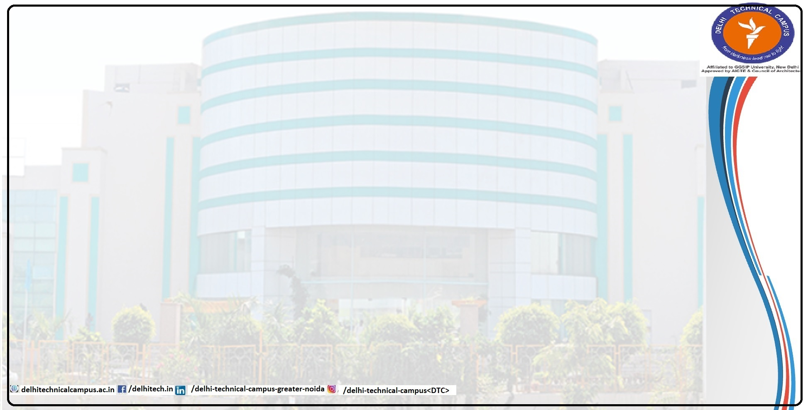
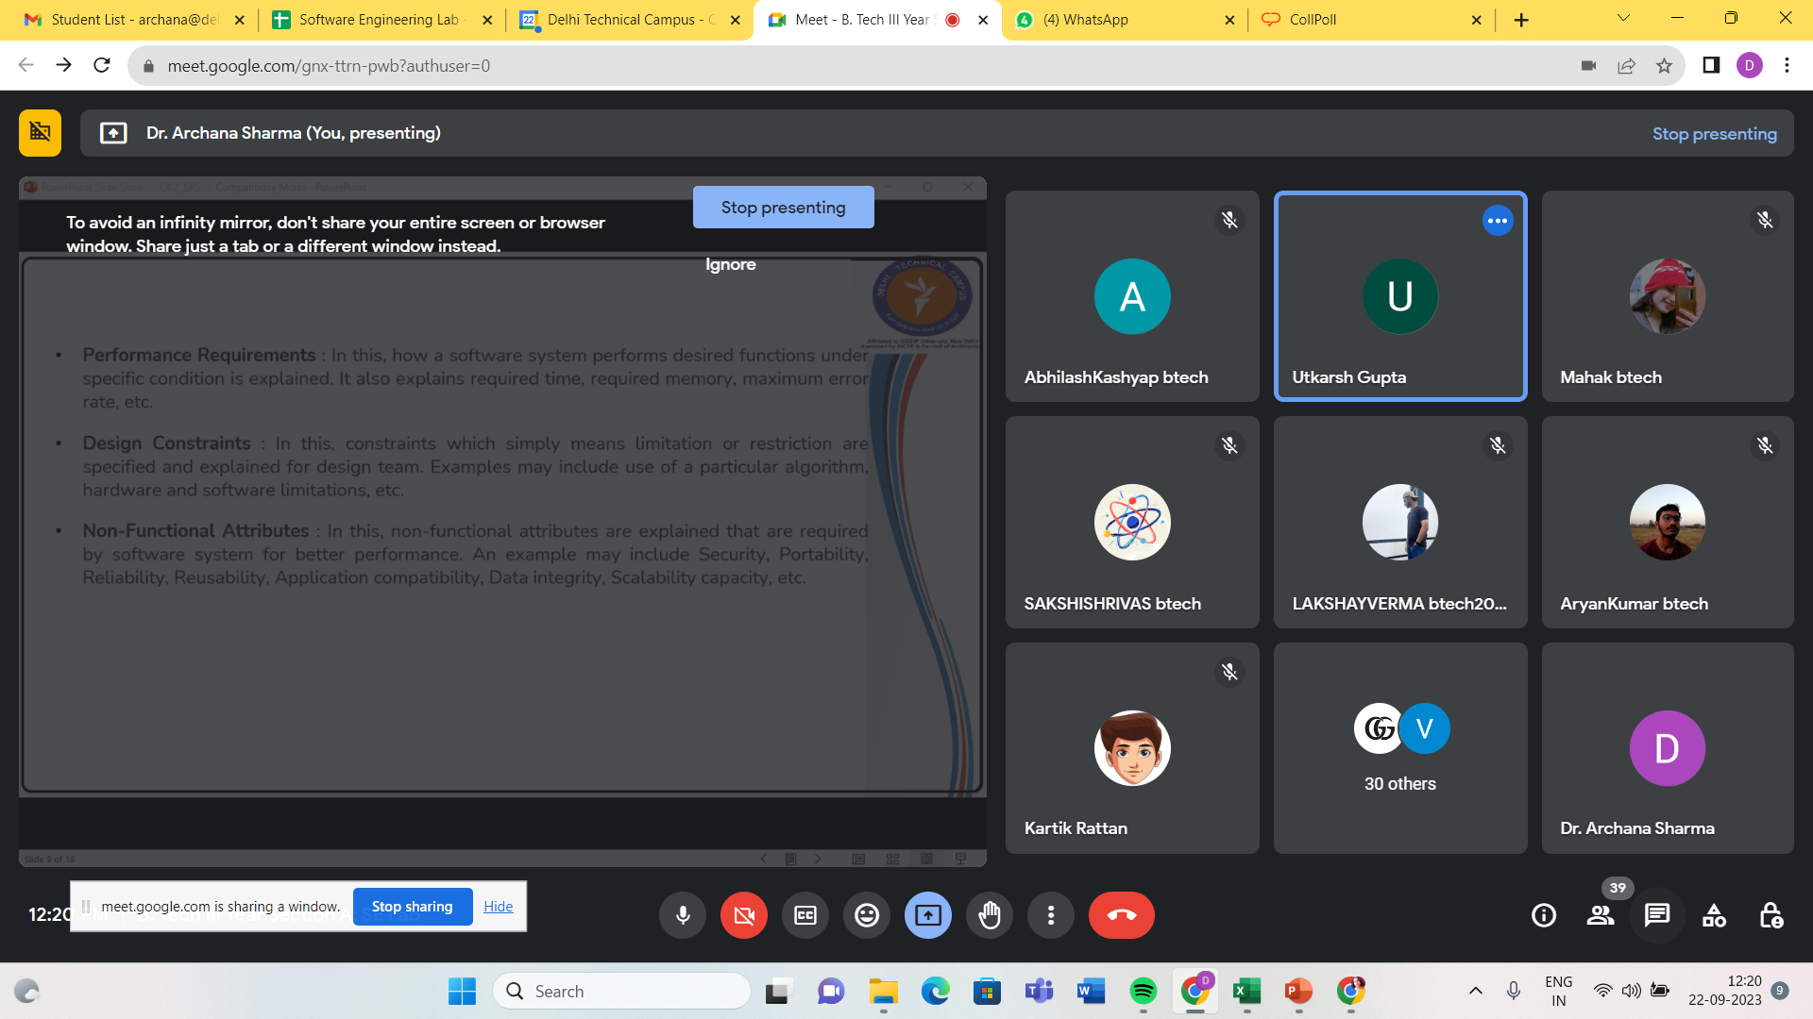
Software Requirement Specification
Prepared By:
Dr. Archana Sharma
archana@delhitechnicalcampus.ac.in

Slide 2
Experiment 2: Do the requirement analysis and develop Software requirement specification sheet for your suggested system
Complete specification and description of requirements of software that needs to be fulfilled for successful development of software system.
These requirements can be functional as well as non-functional depending upon type of requirement.

Slide 3
(i) Purpose of this Document – At first, main aim of why this document is necessary and what’s purpose of document is explained and described.
(ii) Scope of this document – In this, overall working and main objective of document and what value it will provide to customer is described and explained. It also includes a description of development cost and time required.

Slide 4
1). Introduction
1.1 Purpose of this document
1.2 Scope of this Document
1.3 Acronyms
1.4 References
1.5 Intended Audience and Reading Suggestions
1.6 Document Overview
2). Overall description
2.1 Product Perspective
2.2 Product Functions
2.3 User Classes and Characteristics
2.4 Operating Environment
2.5 Design and Implementation Constraints
2.6 User Documentation
2.7 Assumptions and Dependencies

Slide 5
3). External Interface Requirements
3.1 User Interfaces
3.2 Hardware Interfaces
3.3 Software Interfaces
3.4 Communication Interfaces
4). Functional Requirement Specifications (FRS)
4.1 System Features
4.2 Functional Requirements
4.2.1 Front end (Storefront) Requirements
4.2.2 Back end (Administrative Tools) Requirements
4.3 Use Cases
4.3.1 Front end (Storefront)
4.3.2 Back end (Administrative Tools)
5). Non-Funtional Requirements
5.1 Usability Requirements
5.2 Performance Requirements
5.3 Compatibility Requirements
6). Other Requirements

Slide 6
Project: Online Customer Service Web Portal for an Online Cosmetic Company
The purpose of this Software Requirement Specification (SRS) document is to outline the functional and non-functional requirements for the development of an online web portal that provides excellent customer service for an online cosmetic company.
The web portal will allow customers to place online orders for beauty products, and the system will facilitate the order fulfillment process from the customer service department to the warehouse team.

Slide 7
1.1 Scope
The scope of this project includes the following activities:
Customer placing an online order
Customer service department receiving the order
Warehouse department fulfilling and shipping the order
Notifying the customer about the order status
1.2 Out of Scope
The following activities are considered out of scope for this project:
Anything prior to ordering (e.g., product browsing, marketing)
Anything after shipping (e.g., delivery tracking, post-purchase support)
Inventory management
Payment system integration

Slide 8
Overview – In this, description of product is explained. It’s simply summary or overall review of product.
General description : In this, general functions of product which includes objective of user, a user characteristic, features, benefits, about why its importance is mentioned. It also describes features of user community.
Functional Requirements : In this, possible outcome of software system which includes effects due to operation of program is fully explained. All functional requirements which may include calculations, data processing, etc. are placed in a ranked order.
Interface Requirements : In this, software interfaces which mean how software program communicates with each other or users either in form of any language, code, or message are fully described and explained. Examples can be shared memory, data streams, etc.

Slide 9
Performance Requirements : In this, how a software system performs desired functions under specific condition is explained. It also explains required time, required memory, maximum error rate, etc.
Design Constraints : In this, constraints which simply means limitation or restriction are specified and explained for design team. Examples may include use of a particular algorithm, hardware and software limitations, etc.
Non-Functional Attributes : In this, non-functional attributes are explained that are required by software system for better performance. An example may include Security, Portability, Reliability, Reusability, Application compatibility, Data integrity, Scalability capacity, etc.

Slide 10
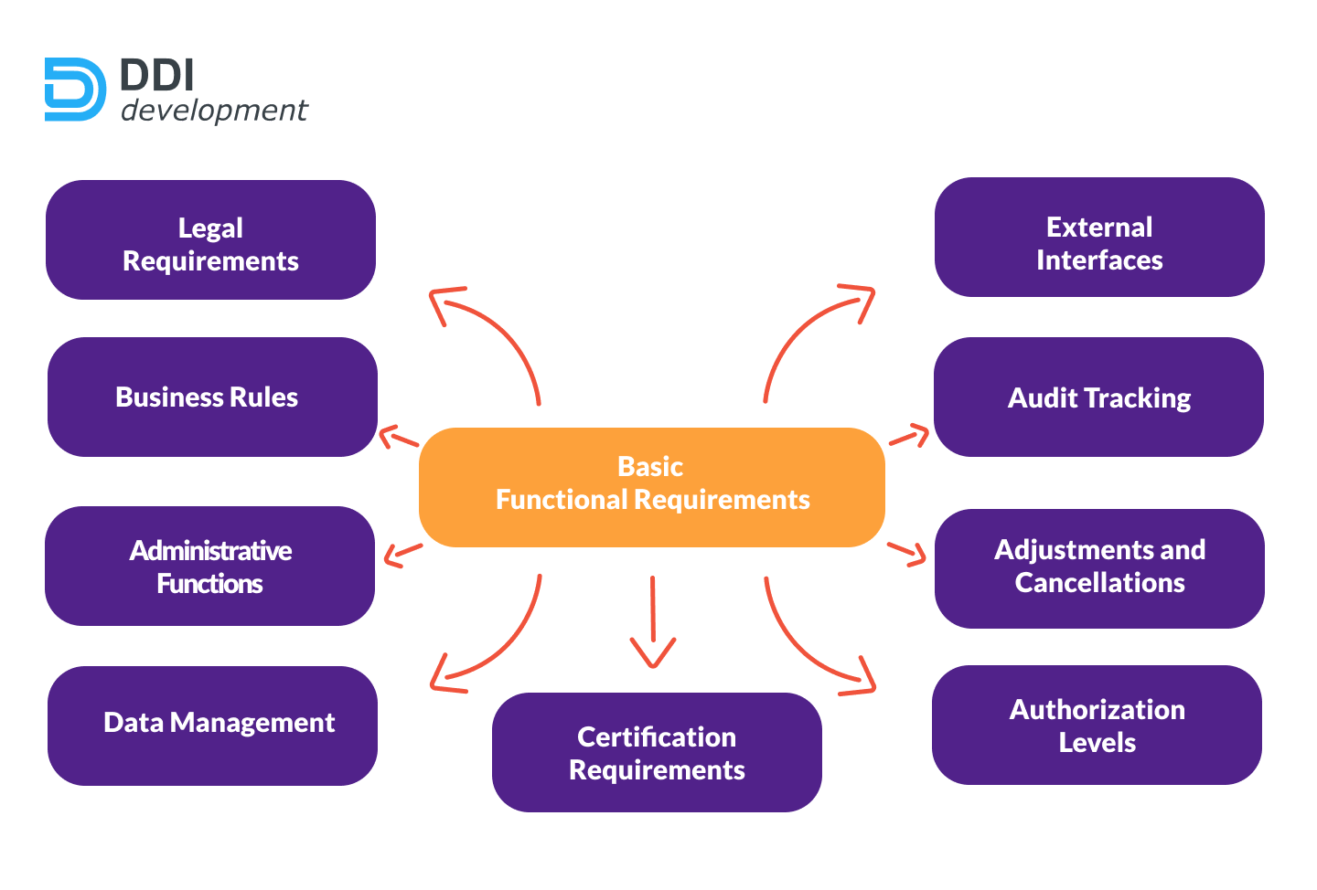

Slide 11
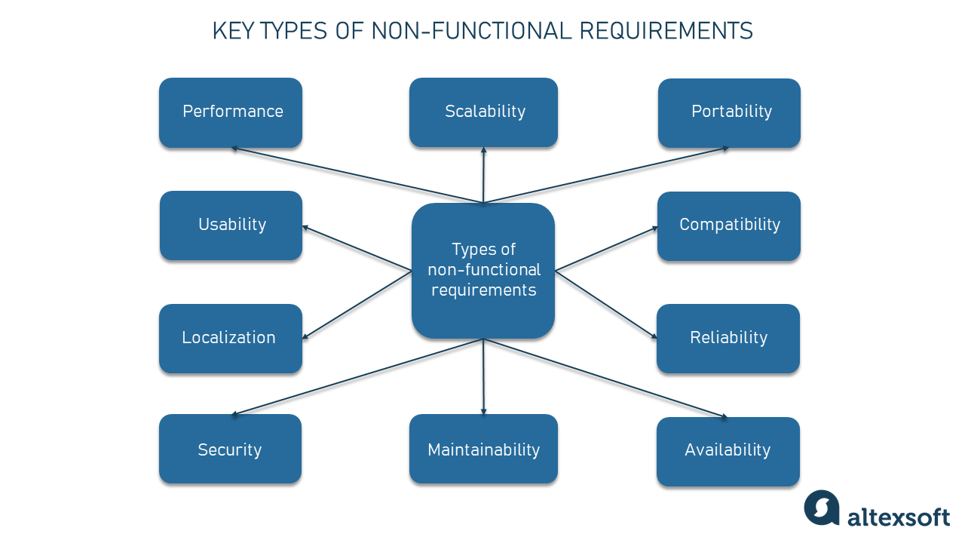

Slide 12
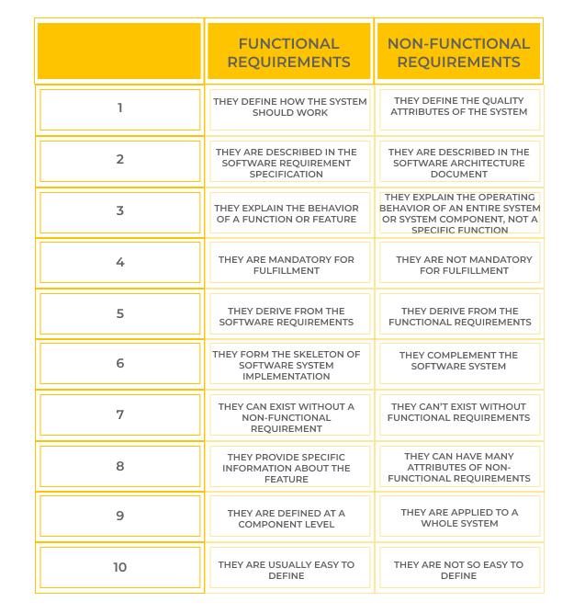

Slide 13
Functional Requirements
2.1 User Registration and Authentication
The web portal shall provide user registration functionality for new customers.
The system shall authenticate users during the order placement process to ensure secure access.
2.2 Order Placement
The web portal shall allow customers to browse and select products for purchase.
Customers shall be able to add products to their shopping cart and specify quantities.
The system shall calculate the order total based on selected products and quantities.
Customers shall be able to review their order and make modifications before finalizing.
The system shall validate and process customer orders.

Slide 14
2.3 Order Reception
The customer service department shall receive customer orders placed through the web portal.
The system shall display order details to the customer service team.
Customer service representatives shall be able to access order information and perform necessary actions.
2.4 Inventory Check and Order Confirmation
The customer service team shall check the inventory system to verify the availability of ordered products.
If the products are in stock, the system shall confirm the order and proceed to order fulfillment.
If the products are out of stock or unavailable within the normal lea

Slide 15
2.5 Order Fulfillment
The warehouse team shall receive confirmed orders from the customer service department.
The system shall facilitate the packaging and shipping process for the ordered items.
The system shall generate a shipping confirmation email with details such as tracking number and estimated delivery date.
The warehouse team shall update the order status in the system after shipping.
2.6 Order Status Notification
The system shall send automated notifications to customers regarding the status of their orders.
Customers shall receive notifications about order confirmation, order fulfillment, and shipping details.
Non-Functional Requirements
3.1 Performance
The web portal shall have low latency and provide a responsive user interface.
The system shall handle multiple concurrent user sessions without performance degradation.
The time taken for inventory checks and order processing shall be optimized to minimize customer wait time.

Slide 16
3.2 Security
The system shall employ secure authentication mechanisms to protect customer information.
Customer data, including personal and payment details, shall be encrypted and stored securely.
Access controls shall be implemented to restrict unauthorized access to sensitive information.
3.3 Reliability
The system shall be available for customer order placement 24/7, with minimal downtime for maintenance.
The system shall have backup and recovery mechanisms to ensure data integrity and availability.
3.4 Usability
The web portal shall have an intuitive and user-friendly interface for easy navigation and order placement.
Error handling and validation messages shall be provided to guide users and prevent incorrect inputs.

Slide 17
3.5 Scalability
The system architecture shall support future scalability to accommodate increasing customer demands.
The web portal shall handle a growing customer base and a larger volume of orders without performance degradation.
Constraints
The development of the web portal should adhere to the company's existing technology stack and infrastructure.
The project should be completed within the allocated budget and timeline.
Integration with the existing inventory management and payment systems is not within the scope of this project.

Slide 18
Preliminary Schedule and Budget : In this, initial version and budget of project plan are explained which include overall time duration required and overall cost required for development of project.
Appendices: In this, additional information like references from where information is gathered, definitions of some specific terms, acronyms, abbreviations, etc. are given and explained.

